Slide 2
Design Patterns
A design pattern is a general repeatable solution to a commonly occurring problem in software design.
A design pattern isn't a finished design that can be transformed directly into code.
It is a description or template for how to solve a problem that can be used in many different situations.

Slide 3
Architectural Patterns vs Design Patterns
The architecture of an application refers to the larger structure and organization of the application, while a design pattern refers to a method of solving a specific type of problem, typically much more focused and lower level than the global structure of the system.
For example, a design pattern can be a solution to the problem of an object's behavior depending on its internal state, or when the behavior of an object depends on the state of other objects in the system.
With architectural level design, you aren't worried about details of how each piece is going to work, you're concerned with how to structure all the pieces together.

Slide 4
History of Design Patterns
In 1994, four authors Erich Gamma, Richard Helm, Ralph Johnson and John Vlissides published a book titled Design Patterns - Elements of Reusable Object-Oriented Software which initiated the concept of Design Pattern in Software development.
These authors are collectively known as Gang of Four (GOF).

Slide 5
Uses of Design Patterns
Effective software design requires considering issues that may not become visible until later in the implementation.
Reusing design patterns helps to prevent subtle issues that can cause major problems and improves code readability for coders and architects familiar with the patterns.
Design patterns allow developers to communicate using well-known, well understood names for software interactions. Common design patterns can be improved over time, making them more robust than ad-hoc designs.

Slide 6
Based on OOP concepts
Class: A class is a collection of method and variables. It is a blueprint that defines the data and behavior of a type.
Object: Instantiation of a class
Encapsulation: Wrapping the data and code. The variables of a class are always hidden from other classes. It can only be accessed using the methods of their current class.
Abstraction: An abstraction is an act of representing essential features without including background details.
Inheritance: One object acquires the properties and behaviors of the parent object. It’s creating a parent-child relationship between two classes.

Slide 7
Based on OOP concepts
Polymorphism: Polymorphism refers to the ability of a variable, object or function to take on multiple forms.
Association: Association is a relationship between two objects. It defines the diversity between objects. In this OOP concept, all object have their separate lifecycle, and there is no owner.
Aggregation: In this technique, all objects have their separate lifecycle. However, there is ownership such that child object can’t belong to another parent object.

Slide 8
Based on OOP concepts
Composition: A composition is a specialized form of Aggregation. It is also called "death" relationship. Child objects do not have their lifecycle so when parent object deletes all child object will also delete automatically.

Slide 9
Types of Design Patterns
Creational Design Patterns
Structural Design Patterns
Behavioral Design Patterns

Slide 10
Interface: An interface in Java is a blueprint of a class. It has static constants and abstract methods. The interface in Java is a mechanism to achieve abstraction. There can be only abstract methods in the Java interface, not method body. It is used to achieve abstraction and multiple inheritance in Java.
Abstract Class: An abstract class is a template definition of methods and variables of a class (category of objects) that contains one or more abstracted methods. Declaring a class as abstract means that it cannot be directly instantiated, which means that an object cannot be created from it.
Concrete Class: A class that is not abstract

Slide 11
Creational Design Patterns
These design patterns are all about class instantiation. This pattern can be further divided into class-creation patterns and object-creational patterns.

Slide 12
Structural Design Patterns
These design patterns are all about Class and Object composition. Structural class-creation patterns use inheritance to compose interfaces. Structural object-patterns define ways to compose objects to obtain new functionality.

Slide 13
Behavioral Design Patterns
These design patterns are all about Class's objects communication. Behavioral patterns are those patterns that are most specifically concerned with communication between objects.

Slide 14
Creational Design Patterns
Singleton
Factory Method

Slide 15
Singleton Pattern
Intent
Ensure a class has only one instance, and provide a global point of access to it.
Problem
Application needs one, and only one, instance of an object.

Slide 16
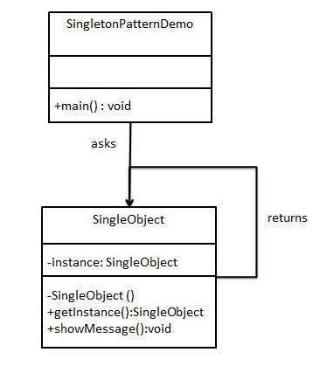
Graphical Representation of Singleton Pattern

Slide 17
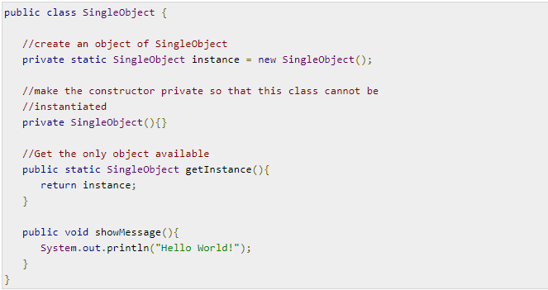
Implementation of Singleton Pattern
Step 1
Create a Singleton Class.

Slide 18
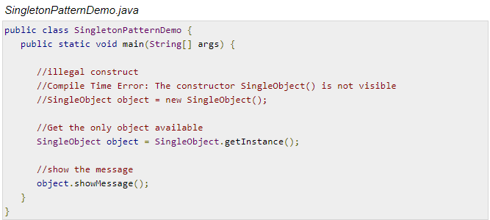
Implementation of Singleton Pattern
Step 2
Get the only object from the singleton class.

Slide 19
Implementation of Singleton Pattern
Step 3
Verify the output.

Slide 20
Singleton Pattern
Summary
This pattern involves a single class which is responsible to create an object while making sure that only single object gets created. This class provides a way to access its only object which can be accessed directly without need to instantiate the object of the class.

Slide 21
Factory Method Pattern
A Factory Pattern or Factory Method Pattern says that just define an interface or abstract class for creating an object but let the subclasses decide which class to instantiate.
In other words, subclasses are responsible to create the instance of the class.
The Factory Method Pattern is also known as Virtual Constructor.

Slide 22
Advantages
Factory Method Pattern allows the sub-classes to choose the type of objects to create.
It promotes the loose-coupling by eliminating the need to bind application-specific classes into the code. That means the code interacts solely with the resultant interface or abstract class, so that it will work with any classes that implement that interface or that extends that abstract class.
Usage
When a class doesn't know what sub-classes will be required to create
When a class wants that its sub-classes specify the objects to be created.

Slide 23
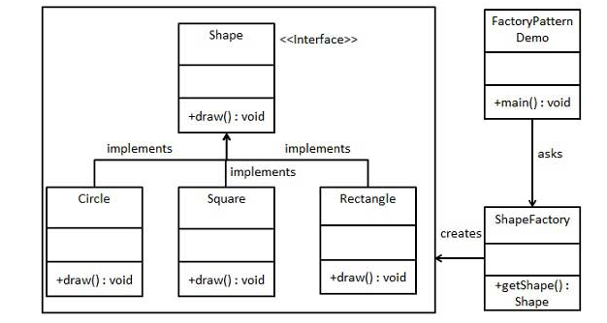
Graphical Representation of Factory Pattern

Slide 24

Implementation of Factory Pattern
Step 1:
Create an interface.

Slide 25
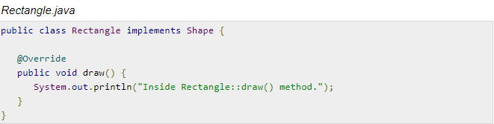
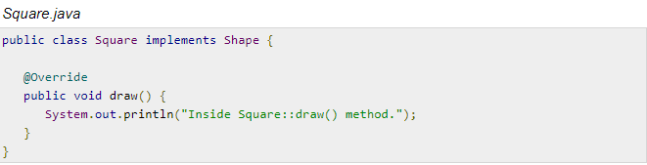
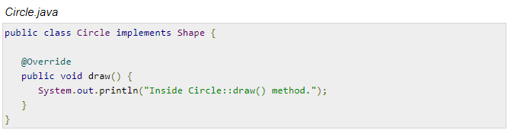
Step 2:
Create concrete classes
implementing the same
interface.

Slide 26
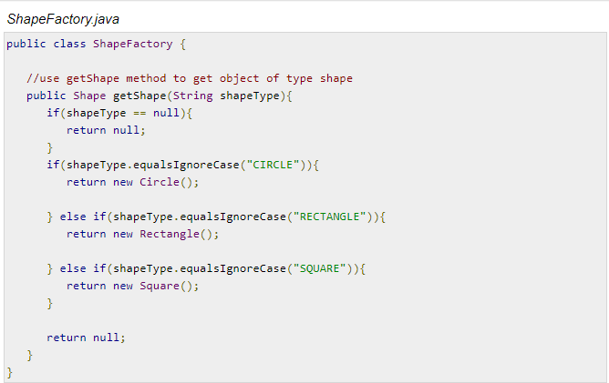
Step 3:
Create a Factory to generate object of concrete class based on given information.

Slide 27
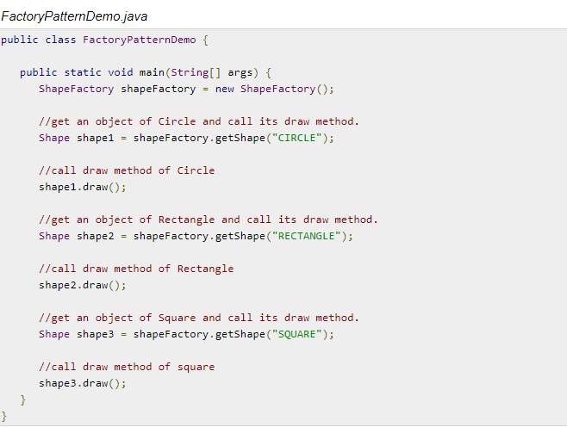
Step 4:
Use the Factory to get object of concrete class by passing an information such as type.

Slide 28

Step 5
Verify the output.

Slide 29
Summary
In Factory pattern, we create object without exposing the creation logic to the client and refer to newly created object using a common interface.

